Slide 1
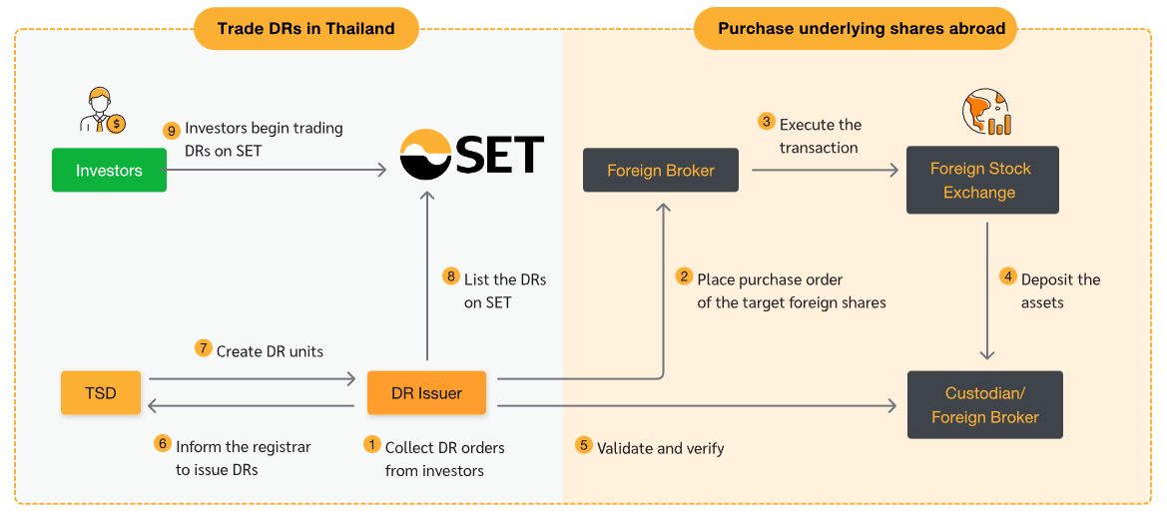

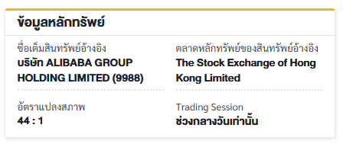
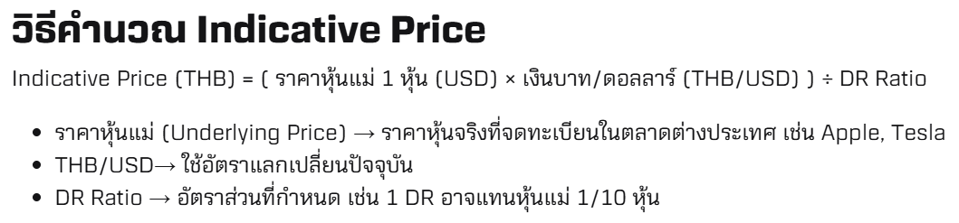
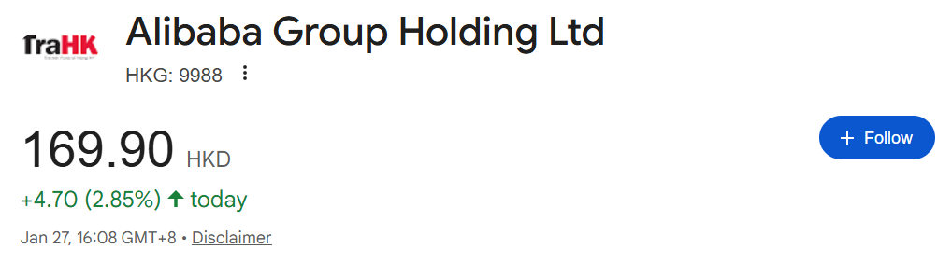
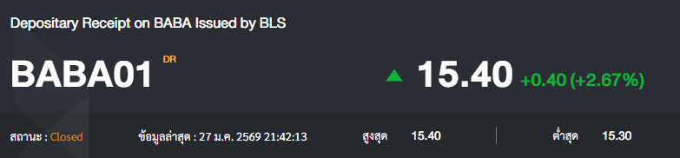
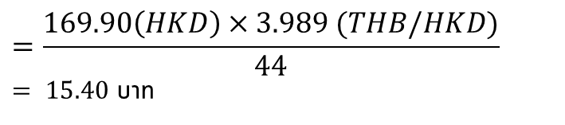
DRs Inefficiency
$$=\frac{169.90\left(HKD\right)×3.989 (THB/HKD)}{44}$$
$= 15.40$ บาท

Slide 2
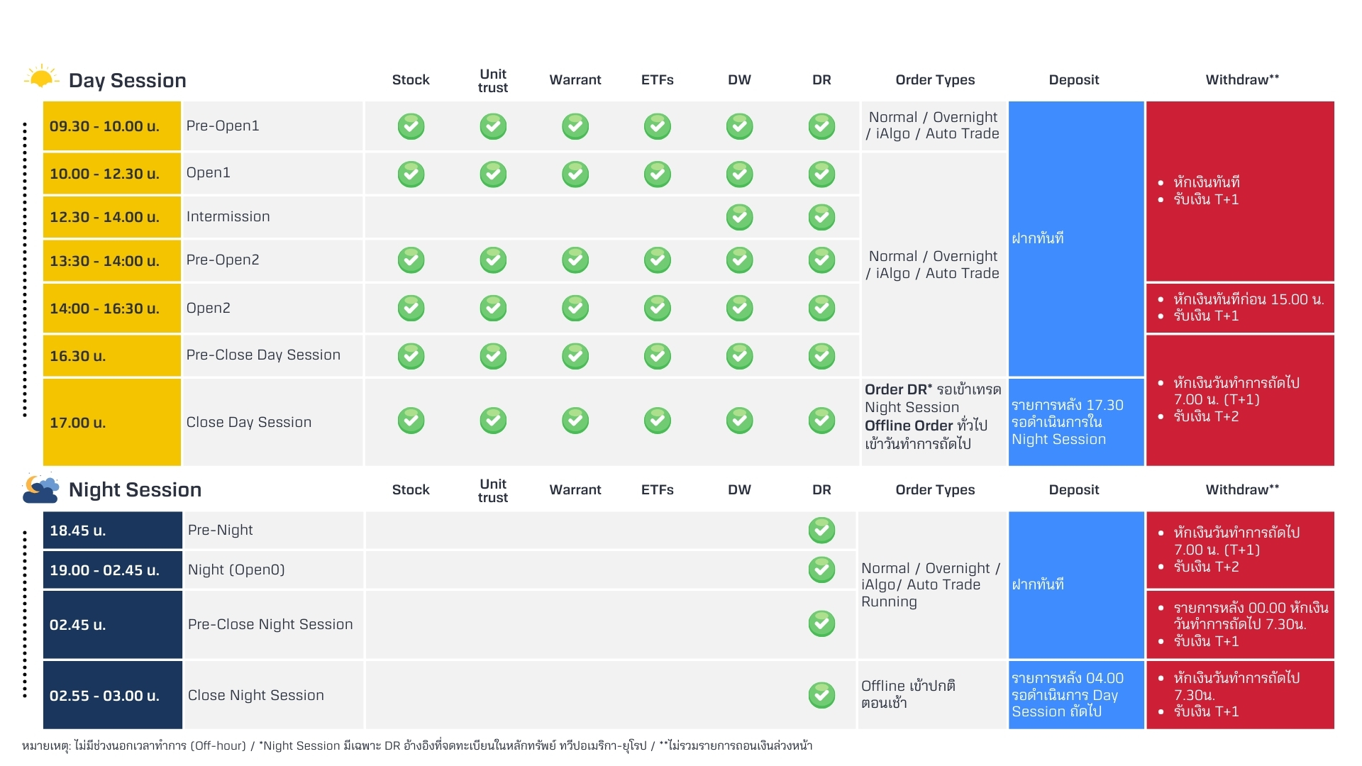
Inefficiency of Indicative Price
Time-zone Mismatch
Relative Value
To avoid FX risk
short holding period (< 5 Day)
Positive from Inefficiency
- Large gap underlying-ticker
- Event Driven
News often hits during US close
DR market trades before US opens
Systematic mispricing at open
Noted: backtesting ignored
Liquidity, Fees
Real spread (OHLC)
Source: https://www.bualuang.co.th/article/nightsession
Strategy 1: Japan Linked DRs
Strategy 2: Hong Kong Linked DRs
Strategy 3: Vietnam Linked DRs
Strategy 4: Europe Linked DRs
Strategy 5: All Linked DRs (Imbalance)

Slide 3
Avoid FX risk: short holding period (<= 1 Day) -> Large gap underlying-ticker or Event Driven
Price Discrepancy
Strategy 1 : Americas & Europe (US/EU) Linked DRs: Relative Value (naked)
Strategy 2 : Japan Linked DRs (AI/ML Post-Earnings)
Strategy 3: Hong Kong Linked DRs (Holiday switching)
Strategy 4: Vietnam Linked DRs: (Regulation)
Strategy 5: Europe Linked DRs (Pre-Earnings front run)
Strategy 6: All Linked DRs: Imbalance
Strategy 7: Secondary linked DRs
# Holiday cross slip
# Premarket surge
# Earnings front run
Concern
Issuer รู้ทัน
Liquidity (Fill and Kill (FAK))
Spread (Tick size increment)
*Each Strategy is different based from timezone, events, and holiday

Slide 4
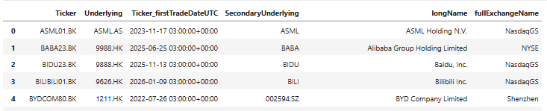
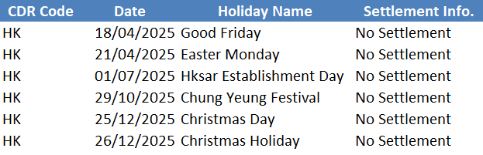
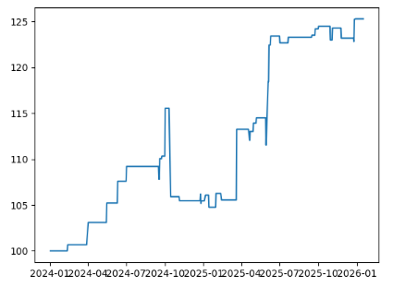
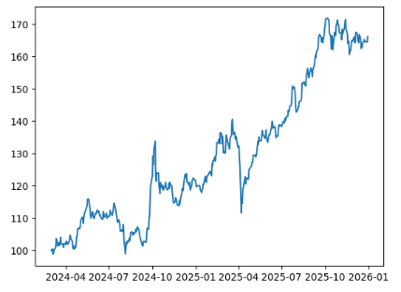
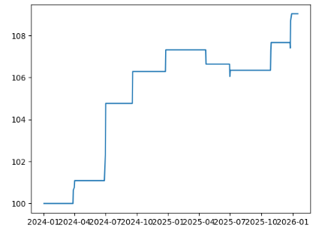
Strategy 2: Hong Kong Linked DRs
Increase trade: Use any underlying related instead.
Holiday
Open
Dates that are holiday in Hong Kong
but not in Shanghai/Shenzhen Exchange Market
Hong Kong – Shenzhen/Shanghai
EMA(Rolling Correlation)
Holiday
Gap threshold
Result (117 trades)
Buy & Hold (Bundle)
Trade stock that listed in both Hong Kong and China only
1 Jan 2024
To
31 Dec 2025
1 Jan 2024 - 31 Dec 2025
Loss if include fees, spread (25 trades)

Slide 5
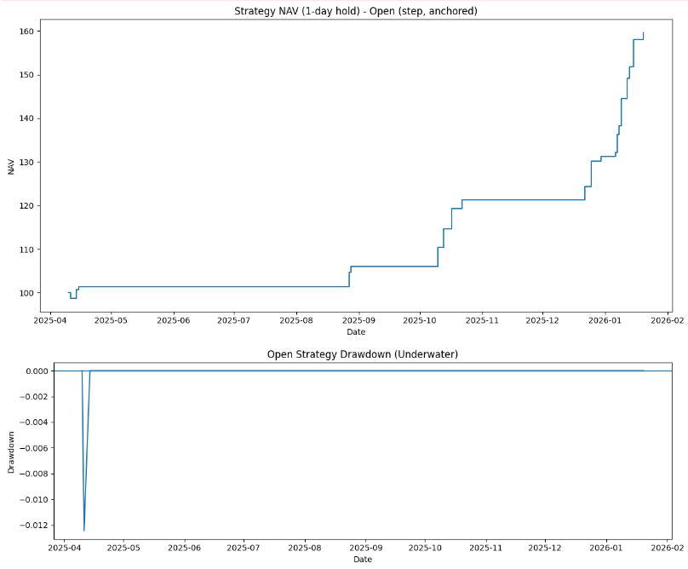
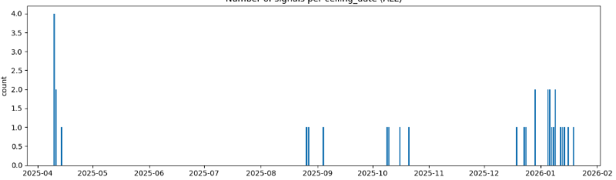
Strategy 4: Vietnam Linked DRs
Start : ≈ 2025-01-01 (since first Vietnam DRs inception)
End : 2026-01-23 (Period : ≈ 1 Year)
Holding period: 1 Day
Hong Kong – Shenzhen/Shanghai
EMA(Rolling Correlation)
Holiday
Gap threshold
+60%
Max Drawdown ≈ 1.2%
Signal Trades (count) = 32

Slide 6
Strategy 2: Hong Kong Linked DRs
Strategy 4: Vietnam Linked DRs
Start : 2025-01-01 (first Vietnam DRs inception)
End : 2026-01-23
Dates that are holiday in Hong Kong
but not in Shanghai/Shenzhen Exchange Market
Hong Kong – Shenzhen/Shanghai
EMA(Rolling Correlation)
Holiday
Gap threshold
Equity Curve +60%
Hong Kong – Shenzhen/Shanghai
Max Drawdown ≈ 1.2%
Signal Trades (count) = 32
Loss if include fees, spread (25 trades)

Slide 7
Strategy 4: Vietnam Linked DRs
Backtesting
Equity Curve +60%
Start : Since first Vietnam Linked DRs inception
(≈ 2025-01-01)
End : 2026-01-23
Ignored : Fees, Spread,
Max Drawdown ≈ 1.2%
Signal Trades (count) = 32

Slide 8
Japan Trading
Example
“7267 JT Equity” earnings report @ 13:00 post-market (GMT+7)
2 hours left (14:30 – 16:30) to decide whether to buy or skip HONDA19 trade
(secondary underlying)
HMC (NYSE DR) premarket
Noted: not every ticker has secondary underlying
VadorSentiment
AI/ML

Slide 9
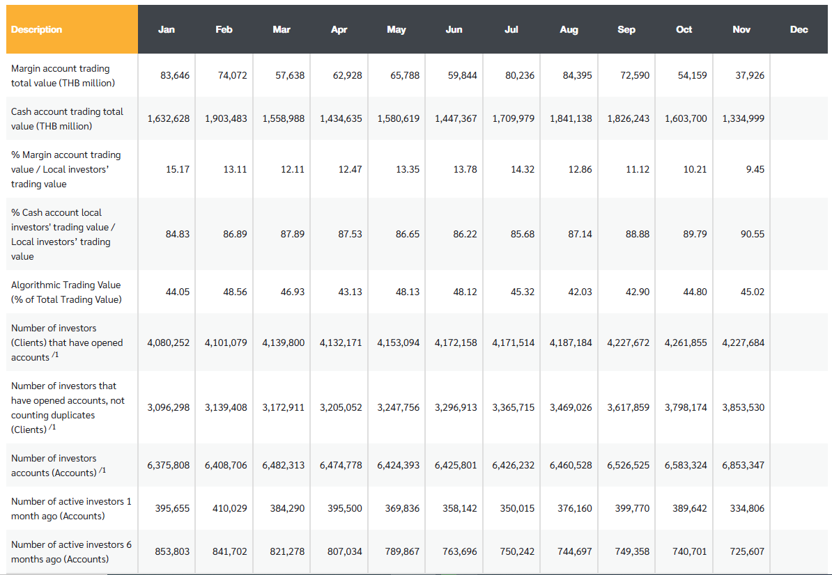
As of 2022
HFT (not all algo) ≈ 9%

Slide 10
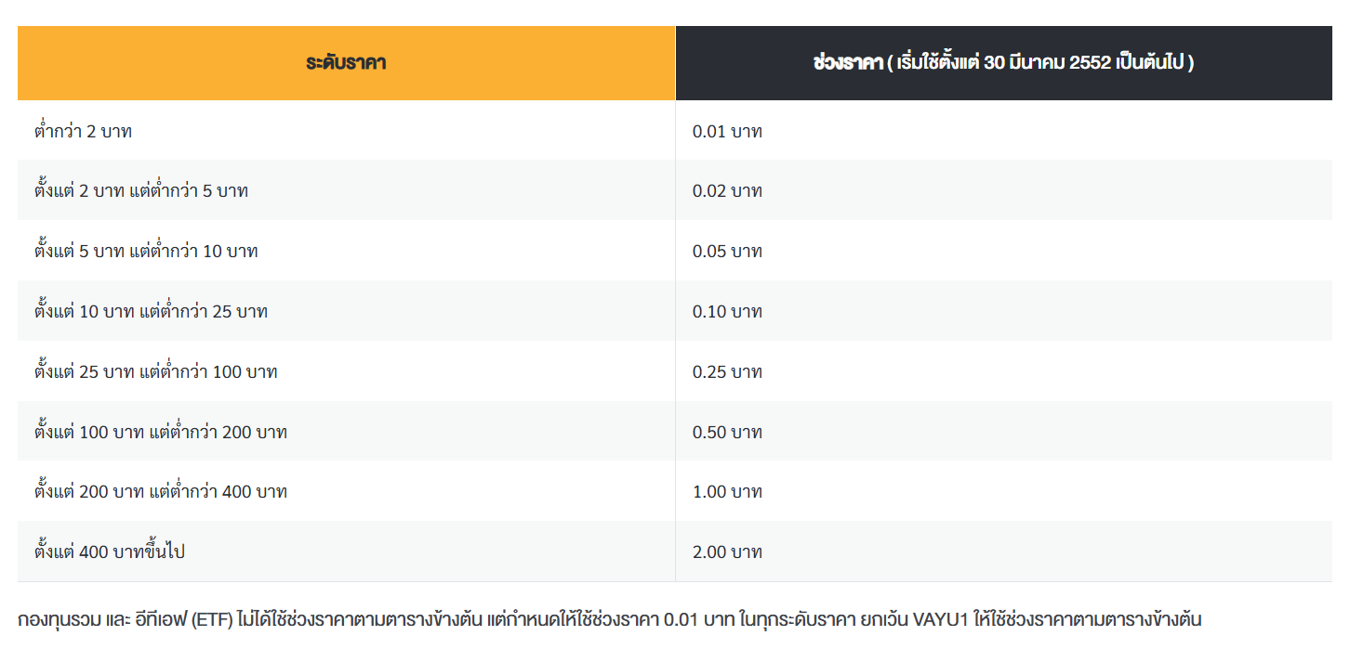
Tick Size: Price Ladder
https://www.set.or.th/th/trading-units-tick-sizes-price-limits

Slide 11
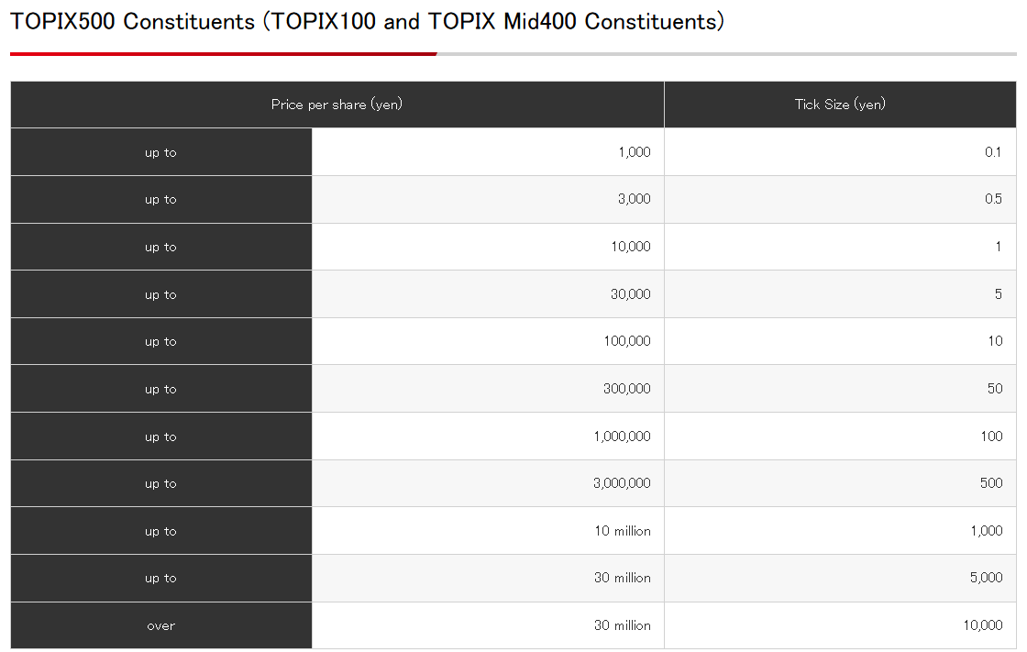
0.01%
0.0167%
0.01%
0.0167%
0.01%
0.0167%
0.01%
0.0167%

Slide 12
relative tick = tick size​ / price
Passive bid before tick size ladder change
Thick top of book (or L2 orderbook)
Time-based order (cancel after 30-180 if not filled and limit buy again)
Tick size ladder
DR arbitrage
DR Ceiling regulation breaks

